Slide 1



Real Estate Project
Web project
Supervisor: Eng/Abdallah

Slide 2

System Functionality
Log in
As admin
Or user
Confirm
Payment
Add advertisement
Feedback

Slide 3


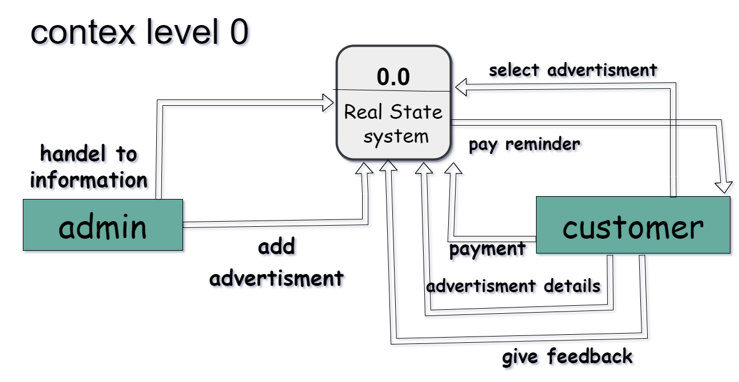
DFD

Slide 4

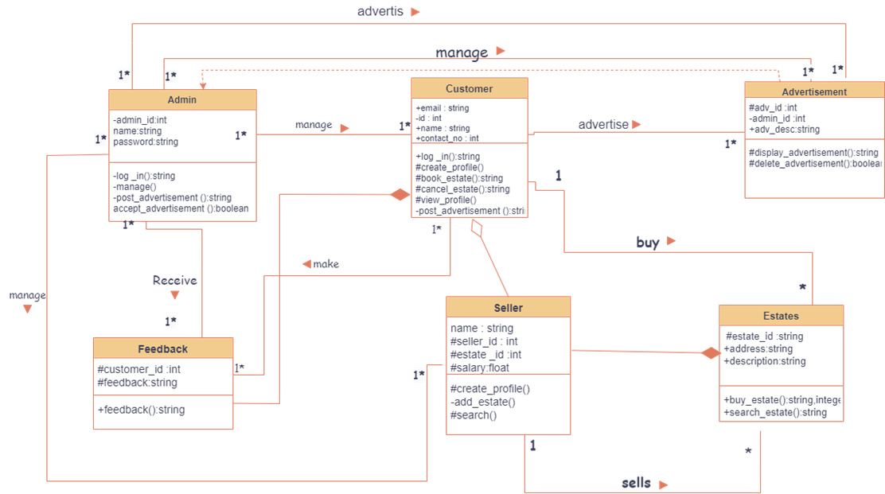
Class diagram
admin
customer
advertisements
seller
feedback
Estate

Slide 5
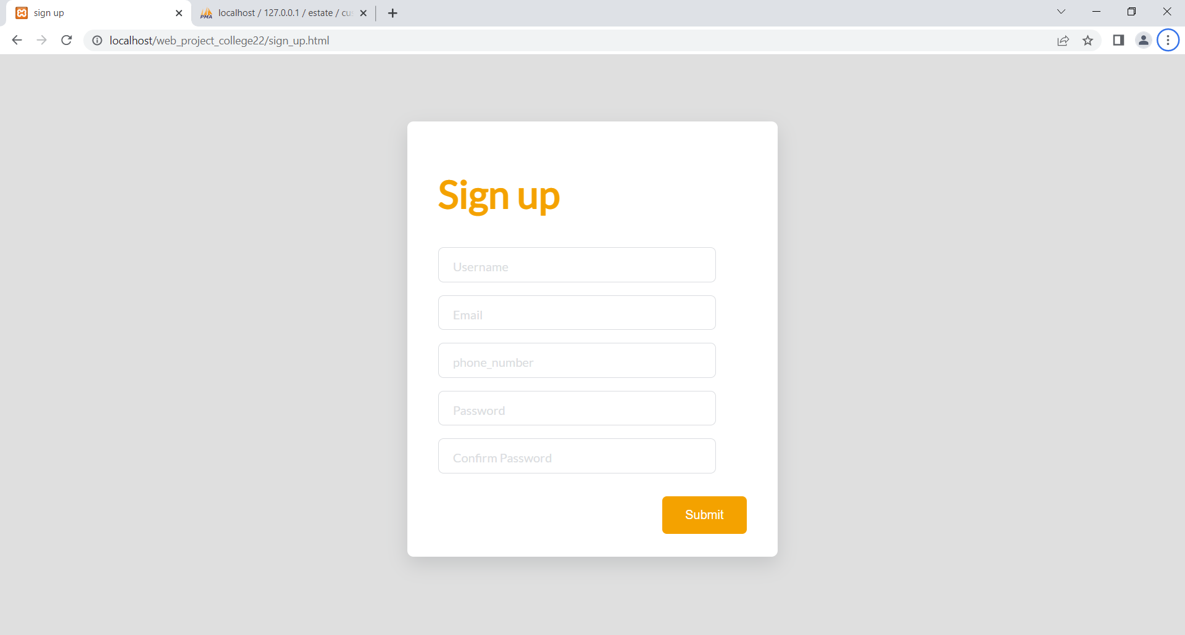

Sign Up
Enter Username
Email
Password
Confirmation Password
Phone Number

Slide 6

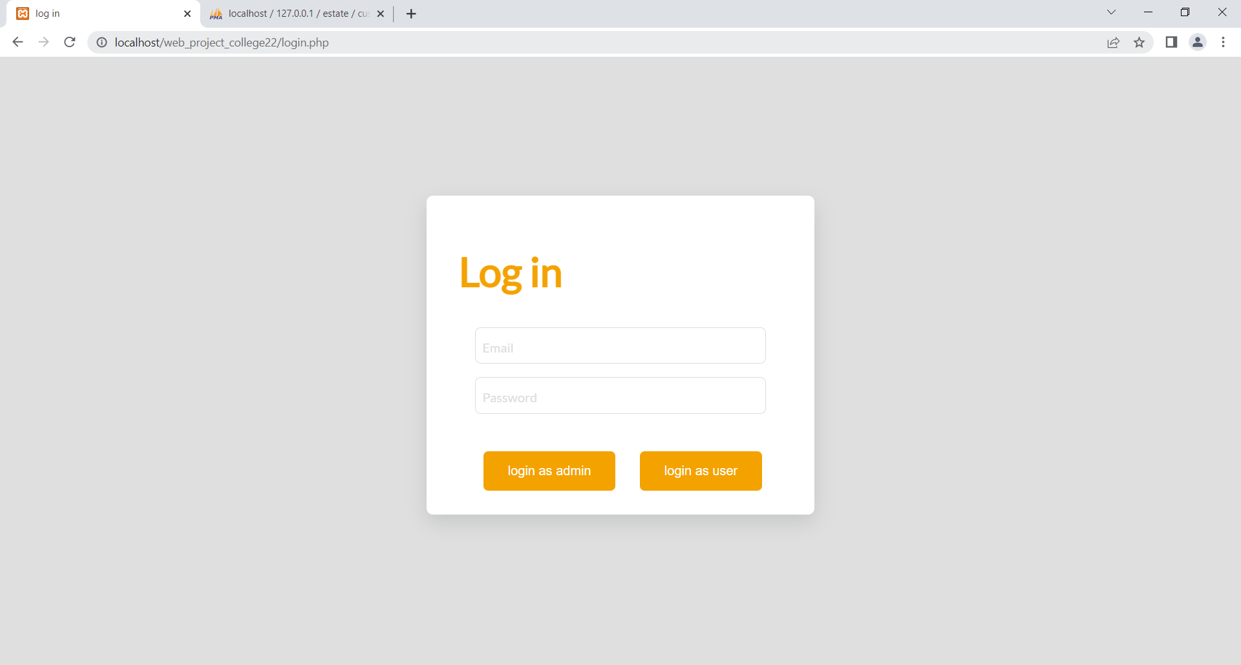
Log in page

Slide 7

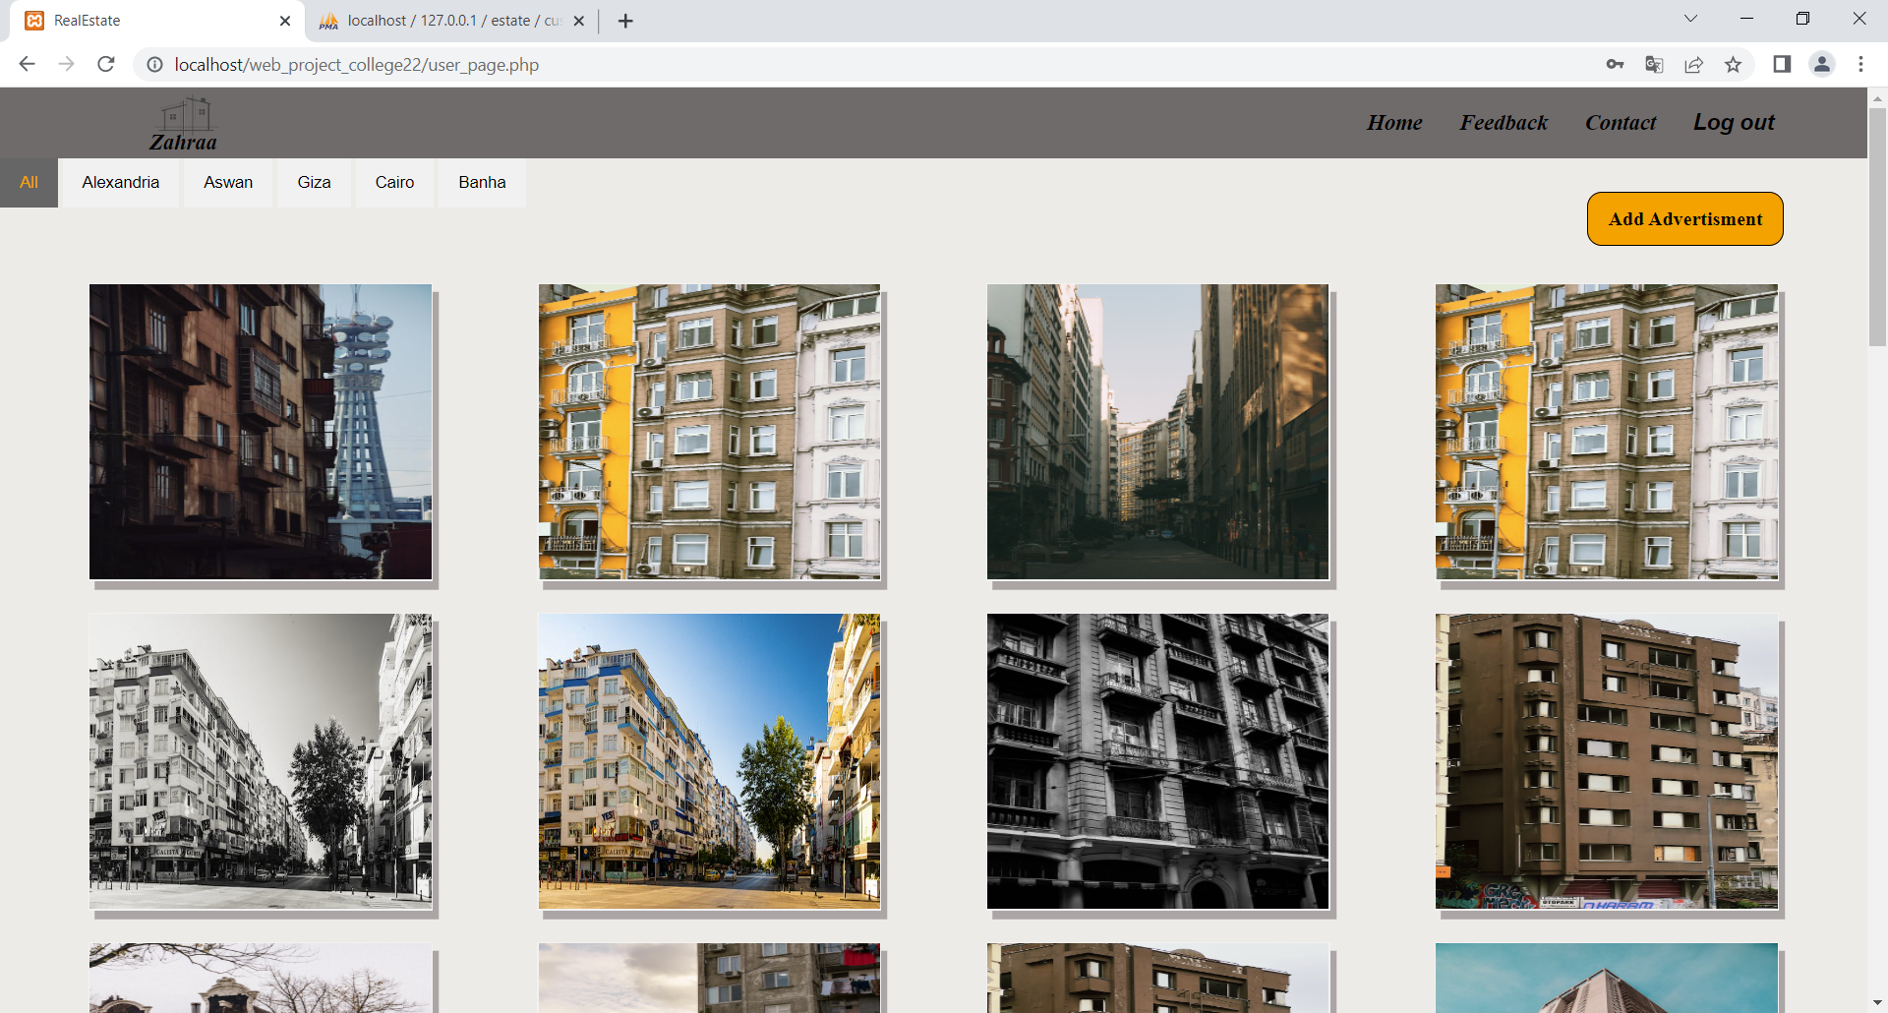
Advertisements
Filter with
location

Slide 8
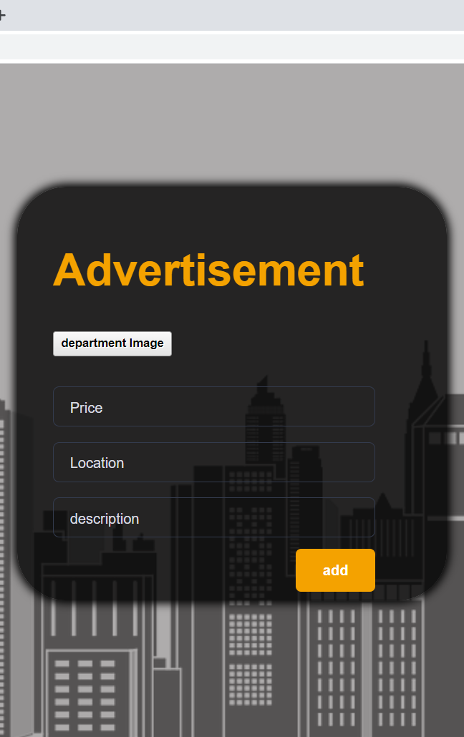
Add Advertisement
Customer
Can
Add advertisement
With
Building information

Slide 9
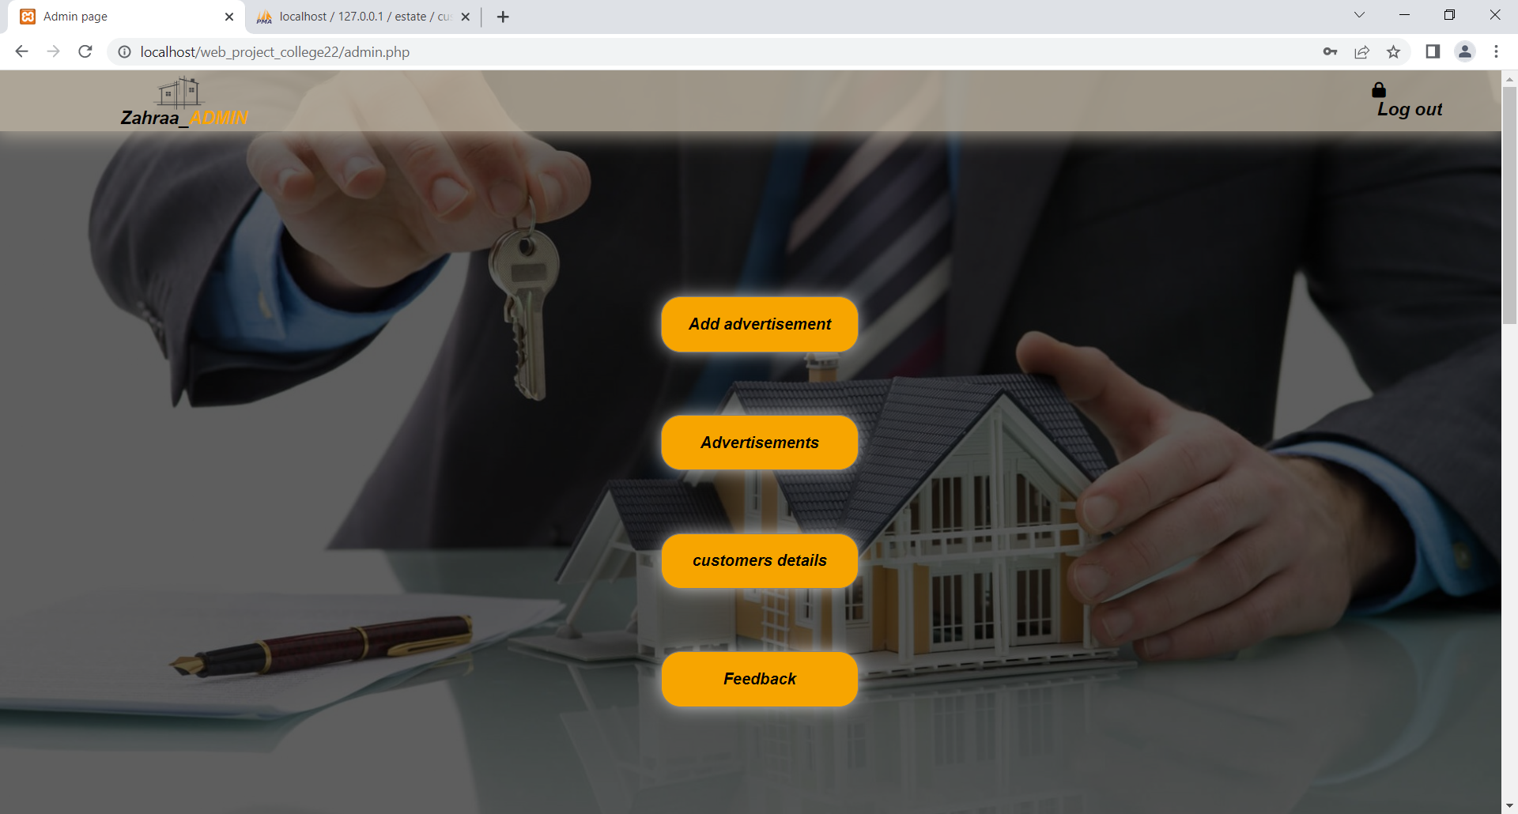
Admin Page
Accept
Advertisements
Customer Data
Feedback

Slide 10
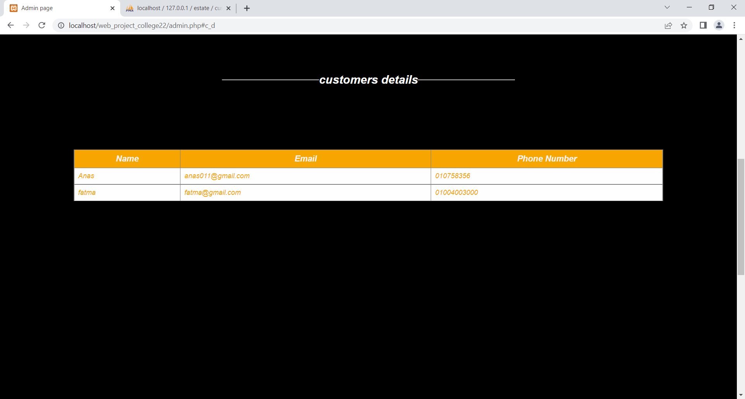


Table 1 for admin

Slide 11
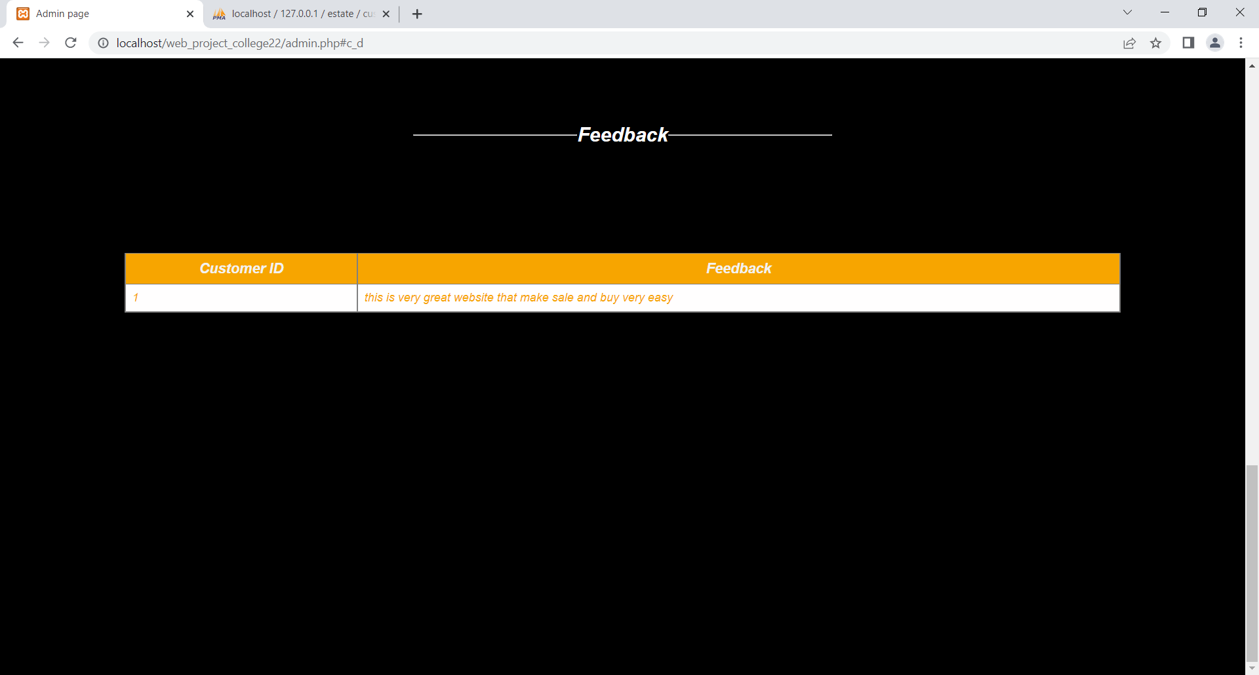

Table 2
For admin

Slide 12
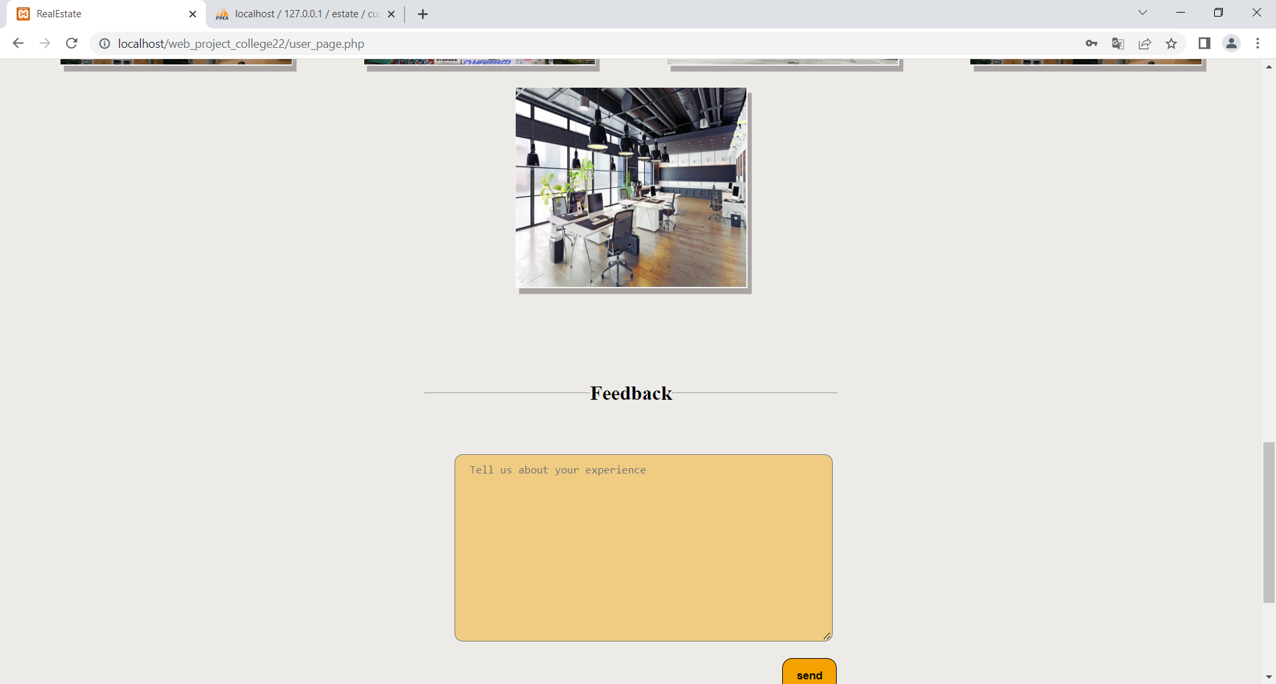
Feedback
For
customer

Slide 13

Thanks

